Slide 1
DETECTING BUILDING DEFECTS USING VGG16
TEAM DETAILS
VADICHERLA NARESH (18UK1A05H7)
LAKKARSU SHIVA (18UK1A05K6)
SAI REVANTH METTELA (18UK1A05M0)
BOMMA KAVYA (18UK1A05J4)

Slide 2
CONTEXT
INTRODUCTION
BLOCK DIAGRAM
EXISTING PROBLEM
PROPOSED SOLUTION
ADVANTAGES
DISADVANTAGES
CONCLUSION
RESULT

Slide 3
INTRODUCTION
Detection of defects including cracks and flakes on the wall surfaces in high-rise buildings is a crucial task of buildings maintenance.
If left undetected and untreated, these defects can significantly affect the structural integrity and the aesthetic aspect of buildings, Time and cost-effective methods of building condition survey are of practicing need for the building owners and maintenance agencies to replace the time- and labor-consuming approach of the manual survey.
In this project detecting building defects such as cracks, flakes, and roof defects, we are usingCNN pre-trained model VGG16 to analyse the type of building defect on the given parameters.
The objective of the project is to build an application to detect the type of building defect.
The model uses an integrated webcam to capture the video frame and the video frame is compared with the pre-trained model and the type of building defect is identified and showcased on the OpenCV window and emergency pull is initiated.

Slide 4
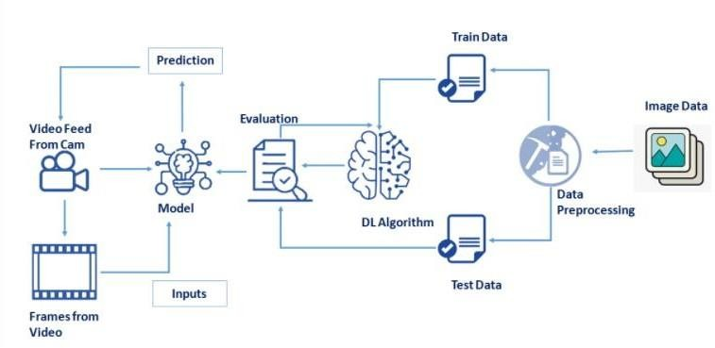
BLOCK DIAGRAM

Slide 5
EXISTING PROBLEM
As the time passes many buildings due to poor maintaince develops defects like cracks, flakesetc., if left undetected it can cause hazardous damages.
Traditional methods for this type of work commonly comprise of engaging building surveyors to undertake a condition assessment which involves a lengthy site inspection
To produce a systematic recording of the physical condition of the building elements, including cost estimates of immediate and projected long-term costs of renewal, repair and maintenance of the building.

Slide 6
PROPOSED SOLUTION
In this project detecting building defects such as cracks, flakes and roof defects, we are using CNN pre-trained model VGG16 to analyse the type of building defect on the given parameters.
The objective of the project is to build an application to detect the type of building defect.
The model uses an integrated webcam to capture the video frame and the video frame is compared with the pre-trained model and the type of building defect is identified and showcased on the OpenCV window and emergency pull is initiated.

Slide 7
ADVANTAGES
Little to no equipment needed
Easy to train
Portable
Minimum Part Preparation
Perfect prediction of the building defects and very accurate performance calculations.

Slide 8
DISADVANTAGES
Surface indications only
Generally, only able to detect large ﬂaws
Possible misinterpretation of ﬂaws
User should have the idea on all the parameters and units of each parameter.

Slide 9
APPLICATIONS
Thermography methodologies fordetecting energy related building defects
Time-lapse thermography for building defect detection
Improvingthedetectionofthermalbridgesinbuildingsviaon-siteinfrared thermography
Geophysical methods for defect detection in architectural structures.

Slide 10
CONCLUSION
We ﬁnally created three web pages in order to translate text from one language to the other language.
In the output language section, we included executing local host in browser.
An image is given as an input from the web cam and the output is in the form of text whether it is cracks, ﬂakes or roof.
Here are the screenshot images of our project.

Slide 11
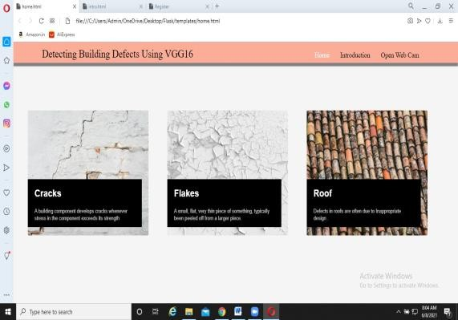
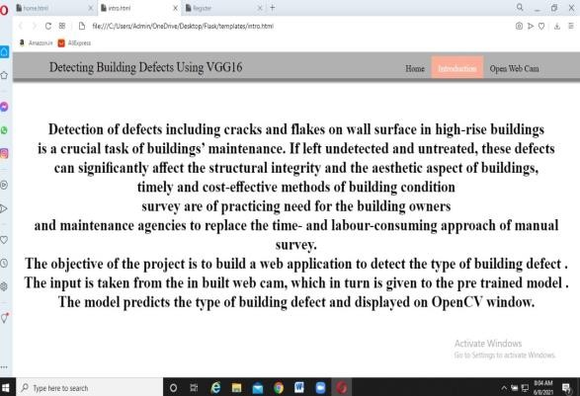
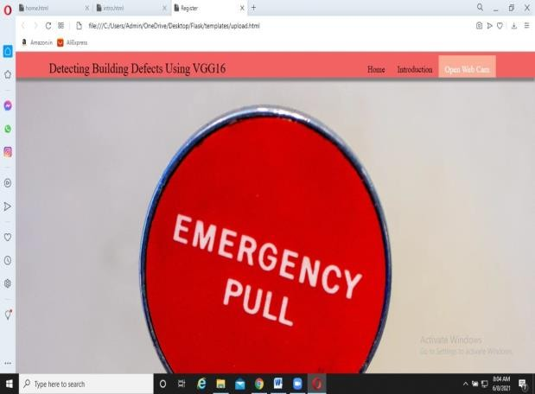
Figure 1. Displays the home page
Figure 2. Displays an introduction about the project
Figure 3. Displays an Emergency alert

Slide 12
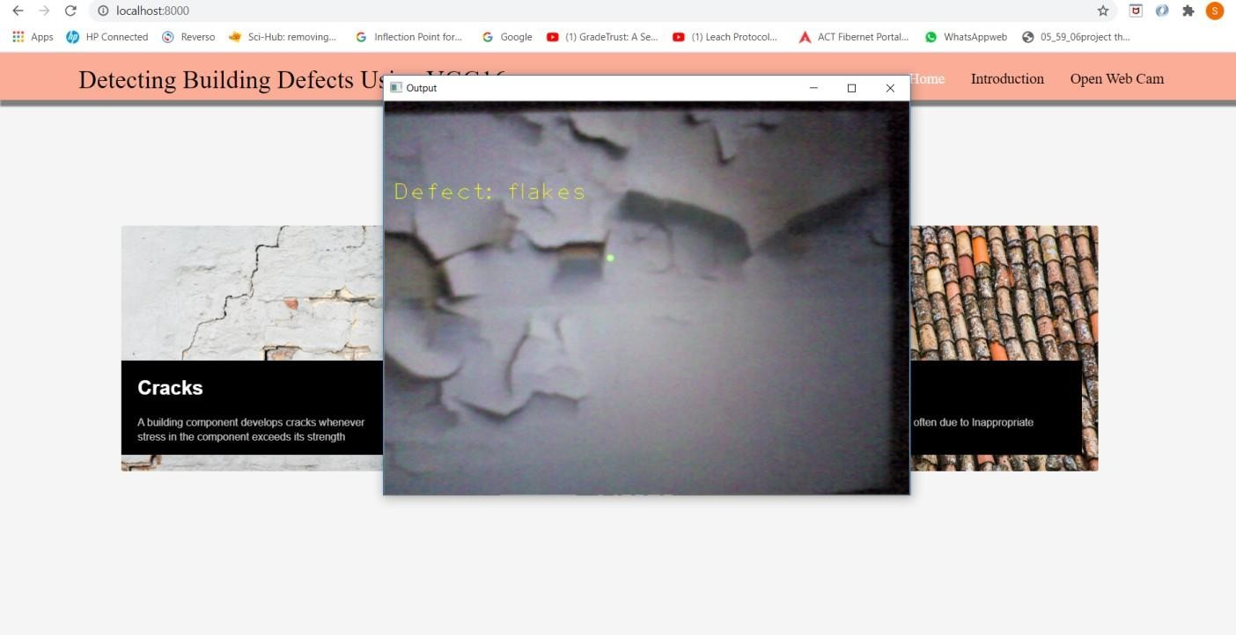
RESULT
The output is displayed in text form.
Figure 4. Output of our project predictions displayed like this

